Slide 1


Online Coaching Application
Coaching Core

Slide 2
Our Team
Shahd Wagdy AbdElfattah
Mohamed Elshaarawy
Abdelrahman AbdElmoaty
Mostafa Helmy
Coaching Core

Slide 3
Our Gym Coaching Application
Our gym coaching application creates a virtual fitness world where users receive personalized workout plans tailored to their fitness goals, considering their fitness level, preferences, and health considerations.
The app ensures a seamless progress tracking system, enabling both clients and coaches to monitor achievements, make informed adjustments, and celebrate milestones.
To enrich the fitness experience, the app provides a diverse resource library featuring nutrition guides and practical fitness tips. This supports users during coaching sessions and empowers them with valuable information for their overall well-being.
In essence, our gym coaching app transforms the coaching experience, creating a nurturing and personalized environment that empowers users on their fitness journey.
Coaching Core

Slide 4


Fitness for All Ages
Kids
Elderly
Discover the importance of physical activity for children and fun ways to keep them active.
Explore fitness options for seniors to maintain strength, flexibility, and overall health in their golden years.
Coaching Core

Slide 5

Coaching Progress Timeline
1
Initial Assessment
Start with an assessment of your current fitness level and goals.
Personalized Workout Plans
2
Receive personalized workout plans tailored to your goals and preferences.
3
Progress Tracking
Track your progress and celebrate milestones with our seamless tracking system.
Coaching Core

Slide 6

Overcoming Challenges
1
Staying Motivated
2
Nutrition Tips
Find ways to stay motivated and committed to your fitness journey.
Discover nutrition tips to support your fitness goals and overall well-being.
3
Recovering from Injuries
Learn techniques for recovering from injuries and preventing future ones.
Coaching Core

Slide 7
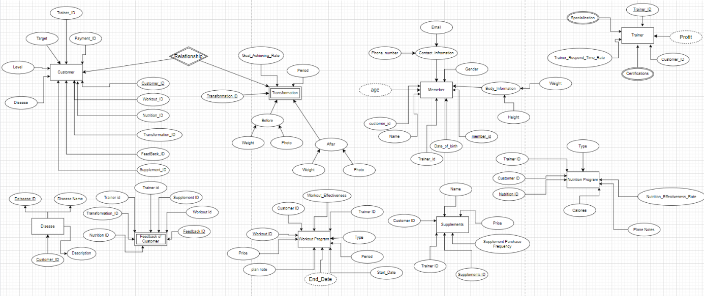
This is the rough schema that explains how we planned the program to look like and the entities it contains.
Coaching Core

Slide 8
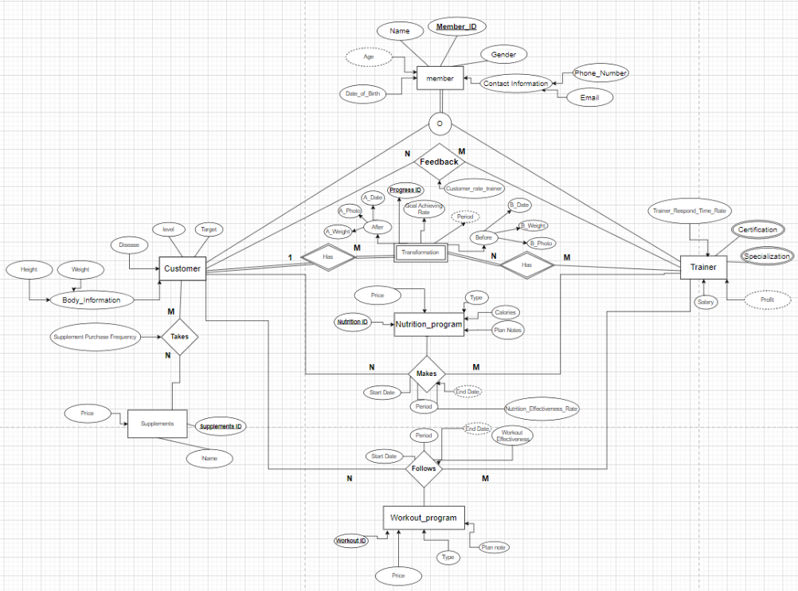
Then we came to this ER that explains the relationship of each entity to the other.
Coaching Core

Slide 9
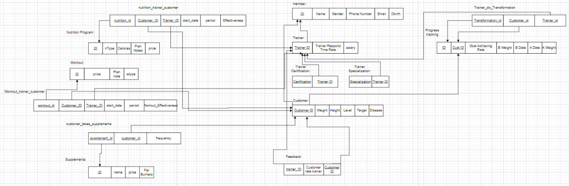
Then we made this mapping to make entering data into the tables clearer.
Coaching Core

Slide 10
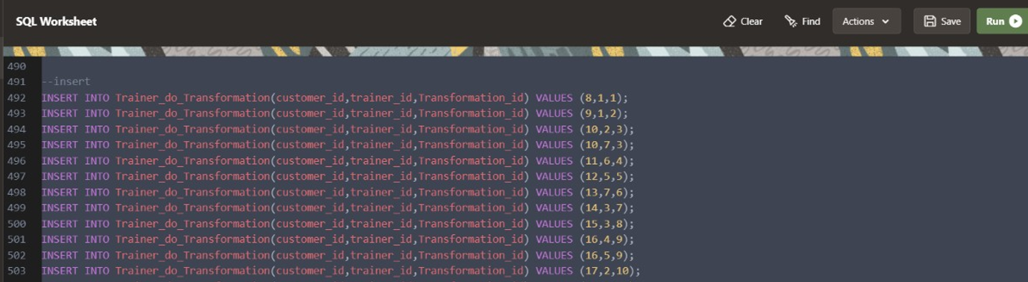
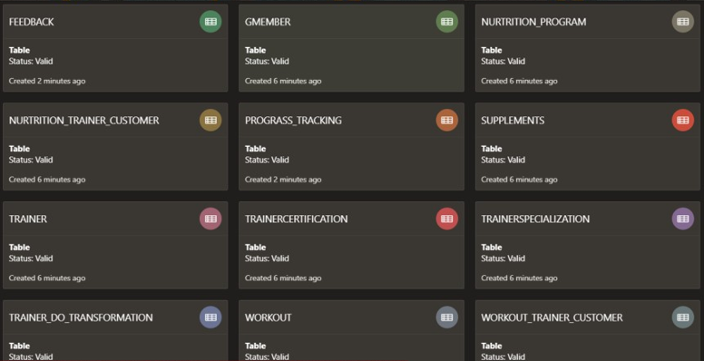
DDL
Coaching Core

Slide 11
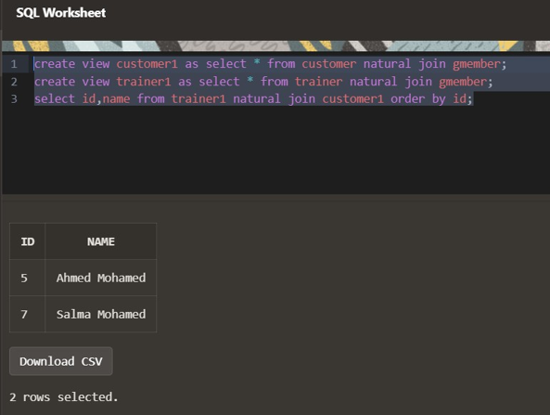
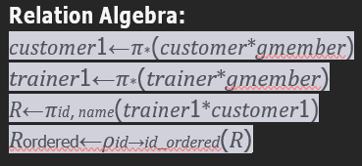
Sample of Complex Query
Retrieve display names and id that trainer is customer. 1st Ǫuery:
Coaching Core

Slide 12
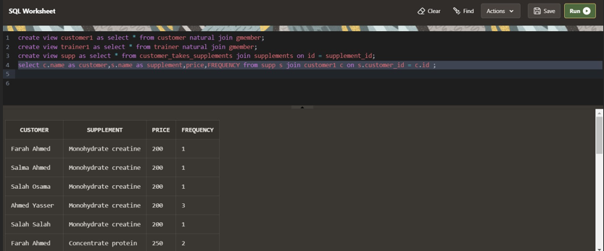
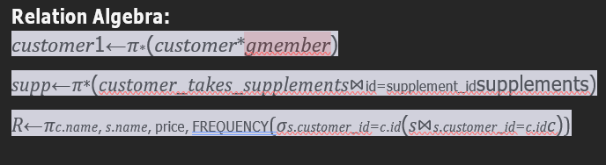
Sample of Complex Query
Retrieve display customer’s name, supplement’s name , price and
FREǪUENCY that customer take supplements
Coaching Core

Slide 13
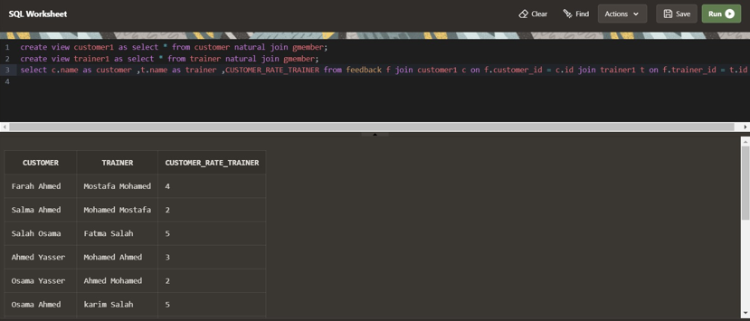
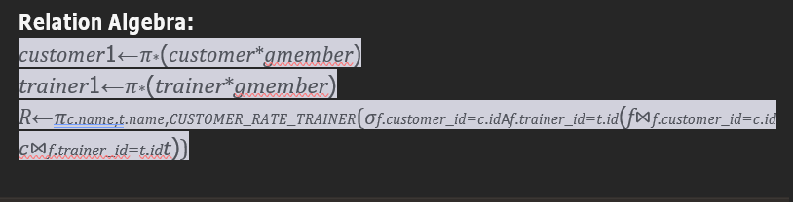
Sample of Complex Query
Retrieve display names and rates for customer feedback trainer
Coaching Core

Slide 14
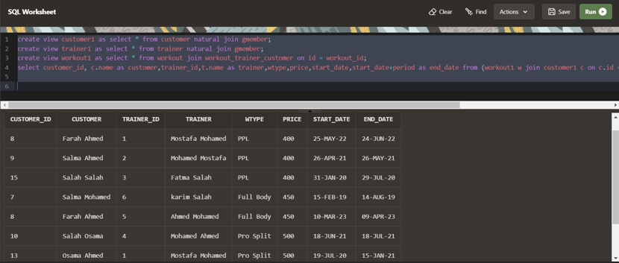
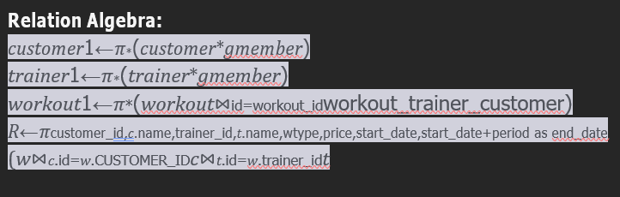
Sample of Complex Query
Retrieve display customer’s name, trainer’s name , type , start date and end date for customer do workout
Coaching Core

Slide 15
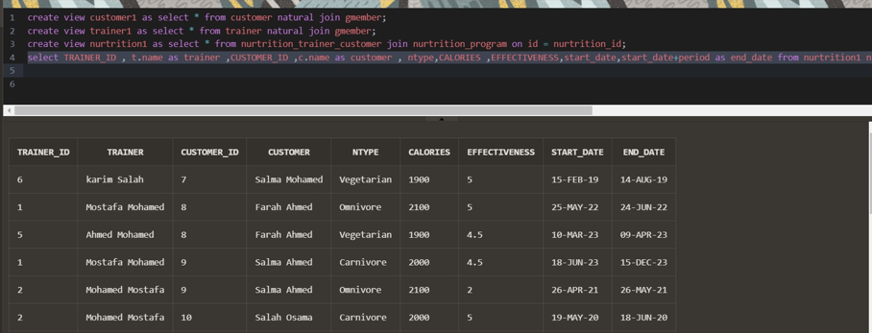
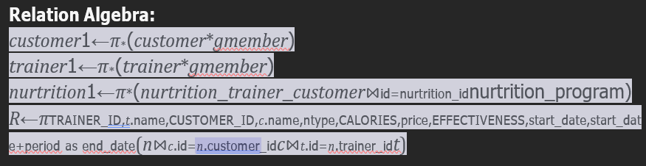
Sample of Complex Query
Retrieve display customer’s name, trainer’s name , type , EFFECTIVENESS ,
CALORIES and start date and end date for customer take nutrition
Coaching Core

Slide 16
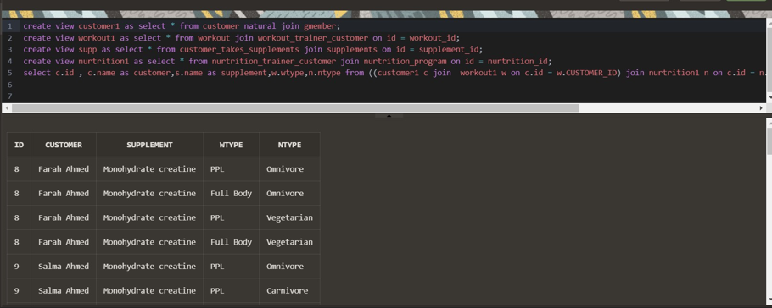
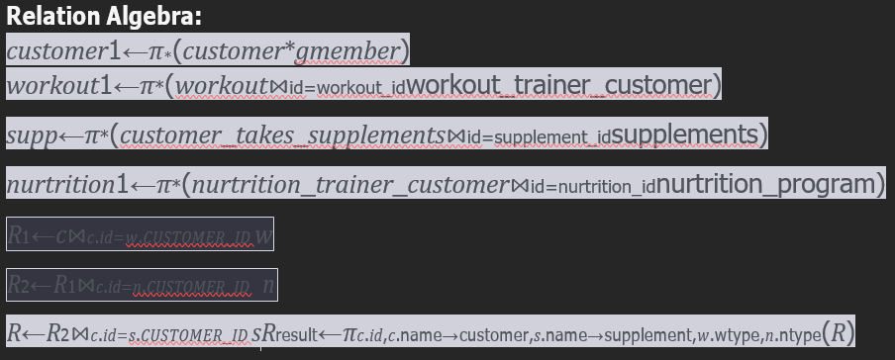
Sample of Complex Query
Retrieve all customers that subscribed All subscription
Coaching Core

Slide 17
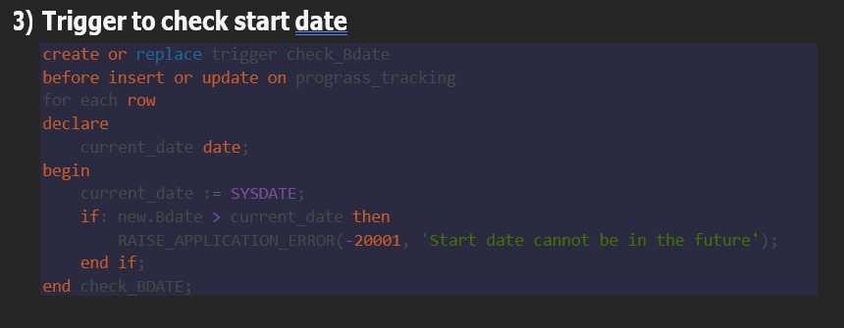
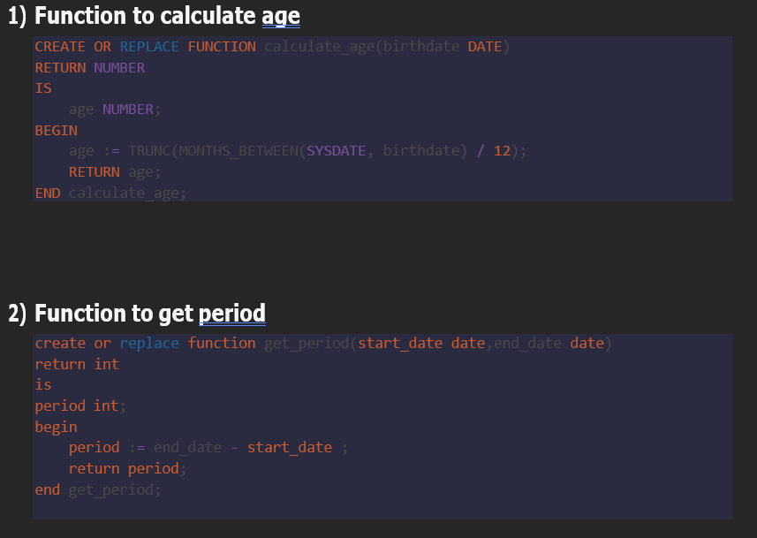
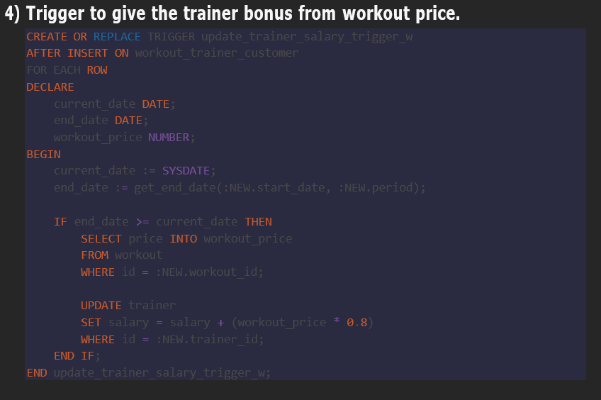
Procedure & Trigger
Coaching Core

Slide 18
Embracing a Healthy Lifestyle
Embrace a healthier lifestyle by incorporating fitness into your daily routine. Discover the rewards of a well-rounded, active life.
Reference : ChatGPT 3.5(for search ) and Bard
Coaching Core

